Slide 1


Slide 2
change nappy

Slide 3
change nappy
plans
prepare infant
prepare nappy
assemble

Slide 4
change nappy
plans
prepare infant
prepare nappy
assemble
goals
strip clothes
clean bum
open
place under
close studs

Slide 5
change nappy
plans
prepare infant
prepare nappy
assemble
goals
strip clothes
clean bum
open
place under
close studs
… /reach X/ /grasp X/ /grasp Y/ /pull Y/ /scoop X/ /Y out of X/ …
motor action

Slide 6
change nappy
plans
prepare infant
prepare nappy
assemble
goals
strip clothes
clean bum
open
place under
close studs
… /reach X/ /grasp X/ /grasp Y/ /pull Y/ /scoop X/ /Y out of X/ …
motor action
… [reach-left-hand X] [left-wholehand-grasp X] [right-wholehand-grasp …

Slide 7
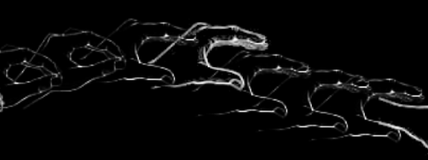
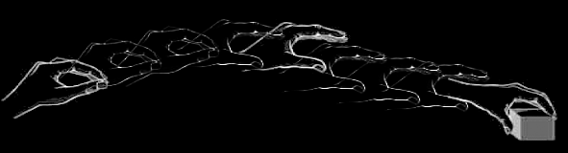
change nappy
plans
prepare infant
prepare nappy
assemble
goals
strip clothes
clean bum
open
place under
close studs
… /reach X/ /grasp X/ /grasp Y/ /pull Y/ /scoop X/ /Y out of X/ …
motor action
… [reach-left-hand X] [left-wholehand-grasp X] [right-wholehand-grasp …
motion
Image adapted from: Rizzolatti, Giacomo, and Giuseppe Luppino. 2001. The Cortical Motor System. Neuron 31, no. 6 (September 27): 889-901. doi:10.1016/S0896-6273(01)00423-8.

Slide 8
change nappy
plans
prepare infant
prepare nappy
assemble
goals
strip clothes
clean bum
open
place under
close studs
… /reach X/ /grasp X/ /grasp Y/ /pull Y/ /scoop X/ /Y out of X/ …
motor action
… [reach-left-hand X] [left-wholehand-grasp X] [right-wholehand-grasp …
motor emulation
motion
Image adapted from: Rizzolatti, Giacomo, and Giuseppe Luppino. 2001. The Cortical Motor System. Neuron 31, no. 6 (September 27): 889-901. doi:10.1016/S0896-6273(01)00423-8.

Slide 9
change nappy
plans
prepare infant
prepare nappy
assemble
goals
strip clothes
clean bum
open
place under
close studs
sequential probabilities
… /reach X/ /grasp X/ /grasp Y/ /pull Y/ /scoop X/ /Y out of X/ …
motor action
… [reach-left-hand X] [left-wholehand-grasp X] [right-wholehand-grasp …
motor emulation
motion
Image adapted from: Rizzolatti, Giacomo, and Giuseppe Luppino. 2001. The Cortical Motor System. Neuron 31, no. 6 (September 27): 889-901. doi:10.1016/S0896-6273(01)00423-8.

Slide 10
change nappy
plans
prepare infant
prepare nappy
assemble
hierarchical patterns
goals
strip clothes
clean bum
open
place under
close studs
sequential probabilities
… /reach X/ /grasp X/ /grasp Y/ /pull Y/ /scoop X/ /Y out of X/ …
motor action
… [reach-left-hand X] [left-wholehand-grasp X] [right-wholehand-grasp …
motor emulation
motion
Image adapted from: Rizzolatti, Giacomo, and Giuseppe Luppino. 2001. The Cortical Motor System. Neuron 31, no. 6 (September 27): 889-901. doi:10.1016/S0896-6273(01)00423-8.

Slide 11
change nappy
plans
prepare infant
prepare nappy
assemble
goals
strip clothes
clean bum
open
place under
close studs
object-directed actions
… /reach X/ /grasp X/ /grasp Y/ /pull Y/ /scoop X/ /Y out of X/ …
… /reach X/ /grasp X/ /grasp Y/
motor action
… [reach-left-hand X] [left-wholehand-grasp X] [right-wholehand-grasp …
motion
Image adapted from: Rizzolatti, Giacomo, and Giuseppe Luppino. 2001. The Cortical Motor System. Neuron 31, no. 6 (September 27): 889-901. doi:10.1016/S0896-6273(01)00423-8.

Slide 12
change nappy
plans
prepare infant
prepare nappy
assemble
goals
strip clothes
clean bum
open
place under
close studs
… /reach X/ /grasp X/ /grasp Y/ /pull Y/ /scoop X/ /Y out of X/ …
motor action
… [reach-left-hand X] [left-wholehand-grasp X] [right-wholehand-grasp …
motion
Image adapted from: Rizzolatti, Giacomo, and Giuseppe Luppino. 2001. The Cortical Motor System. Neuron 31, no. 6 (September 27): 889-901. doi:10.1016/S0896-6273(01)00423-8.

Slide 13


Slide 14

Your field = a set of objects related to you by proximity, orientation, lighting and other factors
You encounter an object = it is in your field
You register an object at a location = you most recently encountered the object at that location

Slide 15
Your field = a set of objects related to you by proximity, orientation, lighting and other factors
You encounter an object = it is in your field
You register an object at a location = you most recently encountered the object at that location
proximity
orientation
lighting
barriers
trajectory

Slide 16
Your field = a set of objects related to you by proximity, orientation, lighting and other factors
You encounter an object = it is in your field
You register an object at a location = you most recently encountered the object at that location
proximity
orientation
lighting
barriers
trajectory

Slide 17
Your field = a set of objects related to you by proximity, orientation, lighting and other factors
You encounter an object = it is in your field
You register an object at a location = you most recently encountered the object at that location
Principle 3: one can’t goal-directedly act on an object unless one has encountered it.
Principle 2: correct registration is a condition of successful action.
Principle 3: when an agent performs a goal-directed action and the goal specifies an object, the agent will act as if the object were actually in the location she registers it at.
proximity
orientation
lighting
barriers
trajectory

Slide 18
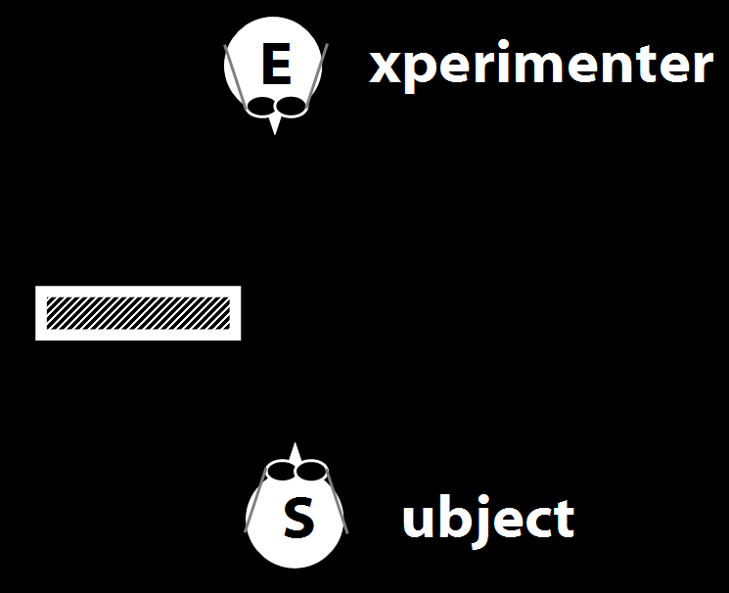
Your field = a set of objects related to you by proximity, orientation, lighting and other factors
You encounter an object = it is in your field
You register an object at a location = you most recently encountered the object at that location
Principle 3: one can’t goal-directedly act on an object unless one has encountered it.
Principle 2: correct registration is a condition of successful action.
Principle 3: when an agent performs a goal-directed action and the goal specifies an object, the agent will act as if the object were actually in the location she registers it at.
proximity
orientation
lighting
barriers
trajectory

Slide 19
Your field = a set of objects related to you by proximity, orientation, lighting and other factors
You encounter an object = it is in your field
You register an object at a location = you most recently encountered the object at that location
Principle 3: one can’t goal-directedly act on an object unless one has encountered it.
Principle 2: correct registration is a condition of successful action.
Principle 3: when an agent performs a goal-directed action and the goal specifies an object, the agent will act as if the object were actually in the location she registers it at.
“children could … think about what the other person saw rather than what they saw”
(Flavell, Shipstead & Croft 1978: 1210)
proximity
orientation
lighting
barriers
trajectory

Slide 20
Your field = a set of objects related to you by proximity, orientation, lighting and other factors
You encounter an object = it is in your field
You register an object at a location = you most recently encountered the object at that location
Principle 3: one can’t goal-directedly act on an object unless one has encountered it.
Principle 2: correct registration is a condition of successful action.
Principle 3: when an agent performs a goal-directed action and the goal specifies an object, the agent will act as if the object were actually in the location she registers it at.
“children could … think about what the other person saw rather than what they saw”
(Flavell, Shipstead & Croft 1978: 1210)
“children could … think about what the other person saw rather than what they saw”
(Flavell, Shipstead & Croft 1978: 1210)
proximity
orientation
lighting
barriers
trajectory

Slide 21
Your field = a set of objects related to you by proximity, orientation, lighting and other factors
You encounter an object = it is in your field
You register an object at a location = you most recently encountered the object at that location
Principle 3: one can’t goal-directedly act on an object unless one has encountered it.
Principle 2: correct registration is a condition of successful action.
Principle 3: when an agent performs a goal-directed action and the goal specifies an object, the agent will act as if the object were actually in the location she registers it at.
proximity
orientation
lighting
barriers
trajectory

Slide 22
Your field = a set of objects related to you by proximity, orientation, lighting and other factors
You encounter an object = it is in your field
You register an object at a location <= you most recently encountered the object at that location
Principle 3: one can’t goal-directedly act on an object unless one has encountered it.
Principle 2: correct registration is a condition of successful action.
Principle 3: when an agent performs a goal-directed action and the goal specifies an object, the agent will act as if the object were actually in the location she registers it at.
proximity
orientation
lighting
barriers
trajectory

Slide 23
Your field = a set of objects related to you by proximity, orientation, lighting and other factors
You encounter an object = it is in your field
You register an object at a location = you most recently encountered the object at that location
Principle 3: one can’t goal-directedly act on an object unless one has encountered it.
Principle 4: correct registration is a condition of successful action.
Principle 3: when an agent performs a goal-directed action and the goal specifies an object, the agent will act as if the object were actually in the location she registers it at.
proximity
orientation
lighting
barriers
trajectory

Slide 24
source: Liszkowski et al (2008)

Slide 25
source: Liszkowski et al (2008)

Slide 26
source: Liszkowski et al (2008)

Slide 27
source: Liszkowski et al (2008)

Slide 28
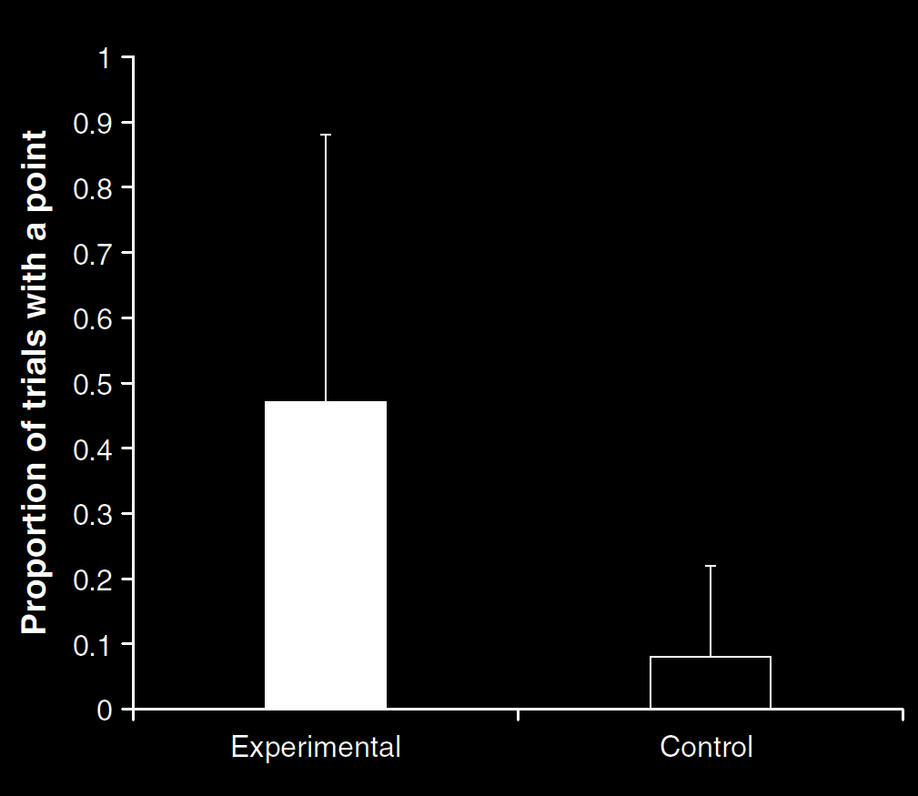
Your field = a set of objects related to you by proximity, orientation, lighting and other factors
You encounter an object = it is in your field
You register an object at a location <= you most recently encountered the object at that location
Principle 3: one can’t goal-directedly act on an object unless one has encountered it.
Principle 4: correct registration is a condition of successful action.
Principle 3: when an agent performs a goal-directed action and the goal specifies an object, the agent will act as if the object were actually in the location she registers it at.
source: Liszkowski et al (2008)
proximity
orientation
lighting
barriers
trajectory

Slide 29
Your field = a set of objects related to you by proximity, orientation, lighting and other factors
You encounter an object = it is in your field
You register an object at a location = you most recently encountered the object at that location
Principle 3: one can’t goal-directedly act on an object unless one has encountered it.
Principle 4: correct registration is a condition of successful action.
Principle 3: when an agent performs a goal-directed action and the goal specifies an object, the agent will act as if the object were actually in the location she registers it at.
“Helping by informing inextricably involves … an understanding of others’ goals and … of others’ ignorance.”
(Liszkowski, Carpenter & Tomasello 2008: 738-9)
source: Liszkowski et al (2008)
proximity
orientation
lighting
barriers
trajectory

Slide 30
Your field = a set of objects related to you by proximity, orientation, lighting and other factors
You encounter an object = it is in your field
You register an object at a location = you most recently encountered the object at that location
Principle 3: one can’t goal-directedly act on an object unless one has encountered it.
Principle 4: correct registration is a condition of successful action.
Principle 3: when an agent performs a goal-directed action and the goal specifies an object, the agent will act as if the object were actually in the location she registers it at.
“Helping by informing inextricably involves … an understanding of others’ goals and … of others’ ignorance.”
(Liszkowski, Carpenter & Tomasello 2008: 738-9)
“Helping by informing inextricably involves … an understanding of others’ goals and … of others’ ignorance.”
(Liszkowski, Carpenter & Tomasello 2008: 738-9)
source: Liszkowski et al (2008)
proximity
orientation
lighting
barriers
trajectory

Slide 31
Your field = a set of objects related to you by proximity, orientation, lighting and other factors
You encounter an object = it is in your field
You register an object at a location <= you most recently encountered the object at that location
Principle 3: one can’t goal-directedly act on an object unless one has encountered it.
Principle 4: correct registration is a condition of successful action.
Principle 3: when an agent performs a goal-directed action and the goal specifies an object, the agent will act as if the object were actually in the location she registers it at.
proximity
orientation
lighting
barriers
trajectory

Slide 32
Your field = a set of objects related to you by proximity, orientation, lighting and other factors
You encounter an object = it is in your field
You register an object at a location <= you most recently encountered the object at that location
Principle 3: one can’t goal-directedly act on an object unless one has encountered it.
Principle 4: correct registration is a condition of successful action.
Principle 5
proximity
orientation
lighting
barriers
trajectory

Slide 33
Your field = a set of objects related to you by proximity, orientation, lighting and other factors
You encounter an object = it is in your field
You register an object at a location <= you most recently encountered the object at that location
Principle 3: one can’t goal-directedly act on an object unless one has encountered it.
Principle 4: correct registration is a condition of successful action.
Principle 5: when an agent performs a goal-directed action and the goal specifies an object, the agent will act as if the object were actually in the location she registers it at.
proximity
orientation
lighting
barriers
trajectory

Slide 34
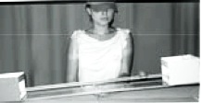
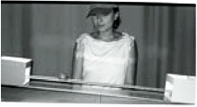
source Träuble, Marinovic, & Pauen (2010)

Slide 35
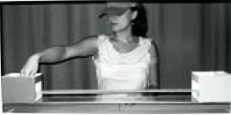
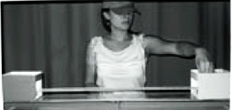
source Träuble, Marinovic, & Pauen (2010)

Slide 36
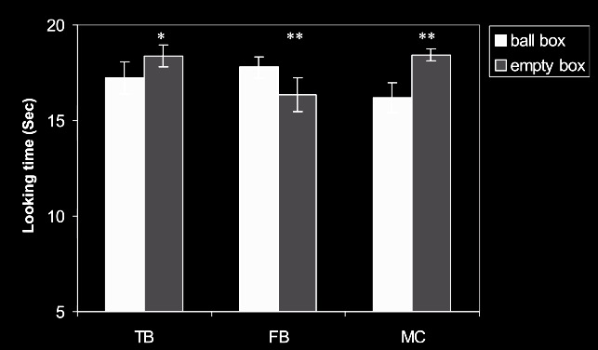
source Träuble, Marinovic, & Pauen (2010)

Slide 37
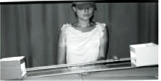
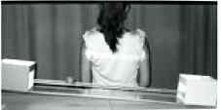
source Träuble, Marinovic, & Pauen (2010)

Slide 38
source Träuble, Marinovic, & Pauen (2010)

Slide 39
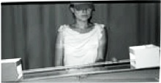
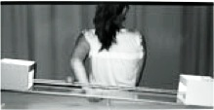
source Träuble, Marinovic, & Pauen (2010)

Slide 40
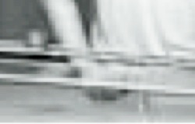
source Träuble, Marinovic, & Pauen (2010)

Slide 41
source Träuble, Marinovic, & Pauen (2010)

Slide 42
Your field = a set of objects related to you by proximity, orientation, lighting and other factors
You encounter an object = it is in your field
You register an object at a location <= you most recently encountered the object at that location
Principle 3: one can’t goal-directedly act on an object unless one has encountered it.
Principle 4: correct registration is a condition of successful action.
Principle 5: when an agent performs a goal-directed action and the goal specifies an object, the agent will act as if the object were actually in the location she registers it at.
proximity
orientation
lighting
barriers
trajectory

Slide 43
Your field = a set of objects related to you by proximity, orientation, lighting and other factors
You encounter an object = it is in your field
You register an object at a location <= you most recently encountered the object at that location
Principle 3: one can’t goal-directedly act on an object unless one has encountered it.
Principle 4: correct registration is a condition of successful action.
Principle 5: when an agent performs a goal-directed action and the goal specifies an object, the agent will act as if the object were actually in the location she registers it at.
proximity
orientation
lighting
barriers
trajectory

Slide 44
Principle 4: correct registration is a condition of successful action.
source Träuble, Marinovic, & Pauen (2010)

Slide 45


